Slide 1



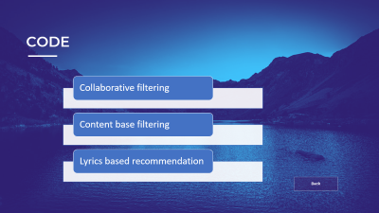
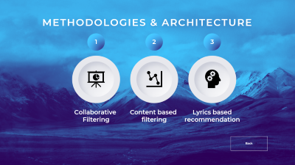
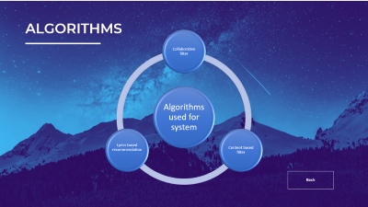
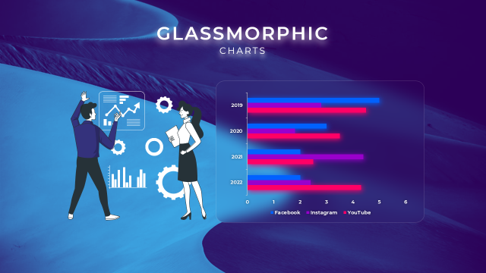

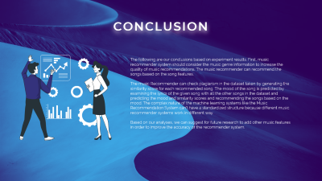


Music Recommendation System
Group 7
Python For Machine Learning
Dr. Sumi Suresh & Dr. Remya S

Slide 2
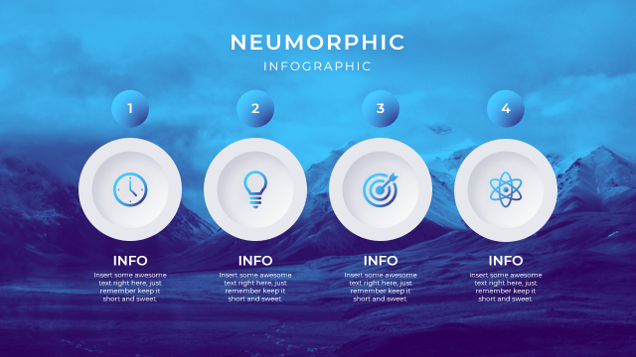


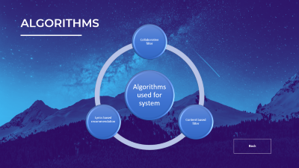
Music Recommendation System
Group 7
Python For Machine Learning
Dr. Sumi Suresh & Dr. Remya S
Notes:
https://duotone.shapefactory.co/?i=-HH3cGeAC4o&f=3fc7ff&t=2c0058&q=_
https://duotone.shapefactory.co/?f=3fc7ff&t=2c0058&q=_

Slide 3
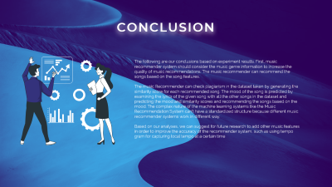

Music Recommendation System
Group 7
Python For Machine Learning
Dr. Sumi Suresh & Dr. Remya S
Notes:
https://duotone.shapefactory.co/?i=-HH3cGeAC4o&f=3fc7ff&t=2c0058&q=_
https://duotone.shapefactory.co/?f=3fc7ff&t=2c0058&q=_

Slide 4
Music Recommendation System
Group 7
Python For Machine Learning
Dr. Sumi Suresh & Dr. Remya S
Notes:
https://duotone.shapefactory.co/?i=-HH3cGeAC4o&f=3fc7ff&t=2c0058&q=_
https://duotone.shapefactory.co/?f=3fc7ff&t=2c0058&q=_

Slide 5
ABOUT THE PROJECT
We present a personalized music recommendation system based on the Matrix factorization and vectorization and machine learning algorithms.
In personalized music recommendation system, we propose a collaborative filtering and content filtering recommendation algorithm to combine the output of the network with the log files to recommend music to the user.
The proposed music recommendation system extracts the user's history from the log file and recommends music under each recommendation. Content based methods gives recommendations based on the similarity of two song contents or attributes while collaborative methods make a prediction on possible preferences using a matrix with ratings on different songs.
LEARN MORE
Back

Slide 6

MACHINE LEARNING
A machine learning model is the output of the training process and is defined as the mathematical representation of the real-world process. The machine learning algorithms find the patterns in the training dataset, which is used to approximate the target function and is responsible for mapping the inputs to the outputs from the available dataset.
There are two main learning algorithms in machine learning:
Supervised learning algorithm are used when the output is classified or labelled. These algorithm learn from the past data that is inputted , called trained data, runs it analysis and uses this analysis to predict future events of any new data within the known classifications.
Unsupervised learning are used when we are aware of the final outputs, and the classification or labelled outputs are not at our disposal. These algorithms study and generate a function to describe completely hidden and unlabelled patterns.
Back

Slide 7



METHODOLOGIES & ARCHITECTURE
1
2
3
Collaborative
Filtering
Content based
filtering
Lyrics based
recommendation
Back
Notes:
https://duotone.shapefactory.co/?i=roZgc7SXXmI&f=3fc7ff&t=2c0058&q=_

Slide 8


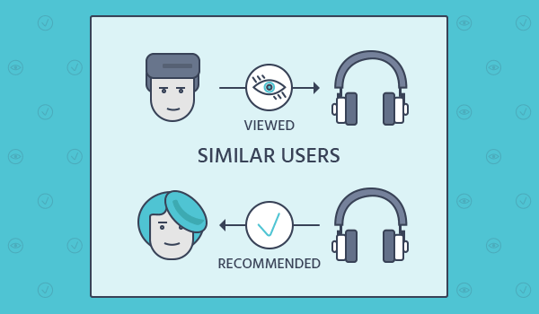
Collaborative Filtering
Collaborative filtering (CF) is a technique used by recommender systems. ... In the newer, narrower sense, collaborative filtering is a method of making automatic predictions (filtering) about the interests of a user by collecting preferences or taste information from many users.
Collaborative-based methods work with an interaction matrix, also called rating matrix. The aim of this algorithm is to learn a function that can predict if a user will benefit from an item meaning the user will likely buy, listen to, watch this item. Among collaborative-based systems, we can encounter two types: user item filtering and item-item filtering.
Back
Notes:
https://duotone.shapefactory.co/?i=phIFdC6lA4E&f=3fc7ff&t=2c0058&q=_

Slide 9
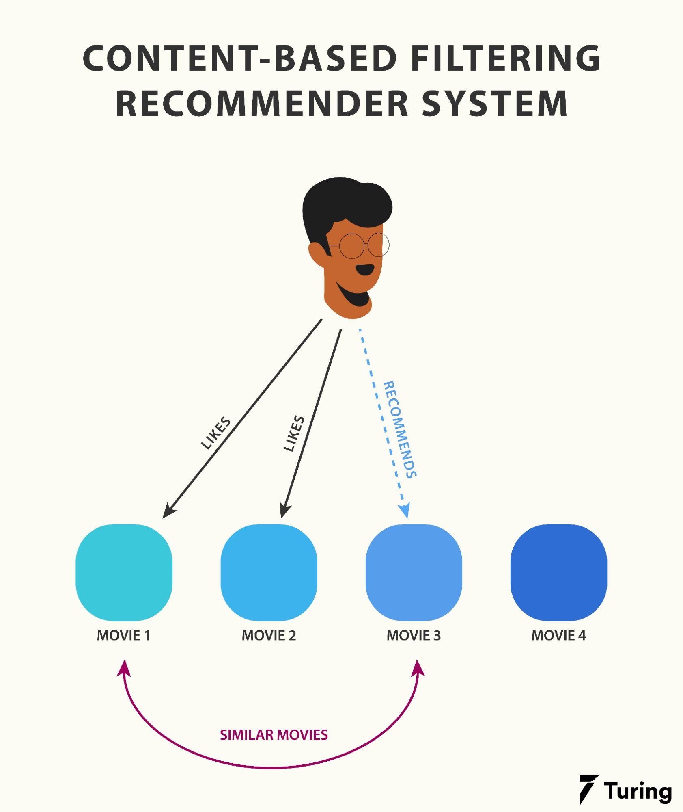
Content based filter
Content-based filtering is a method of recommending items to a user based on their past interactions or behavior. It is a type of collaborative filtering that uses the attributes or characteristics of an item to recommend similar items to a user. For example, if a user has previously watched action movies, a content-based recommendation system might recommend other action movies to them. This method is based on the idea that a user's past behavior can indicate their preferences and therefore, they will like similar items in the future.
Because we are working with text and words, Term Frequency-Inverse Document Frequency (TF-IDF) can be used for this matching process.
Back

Slide 10
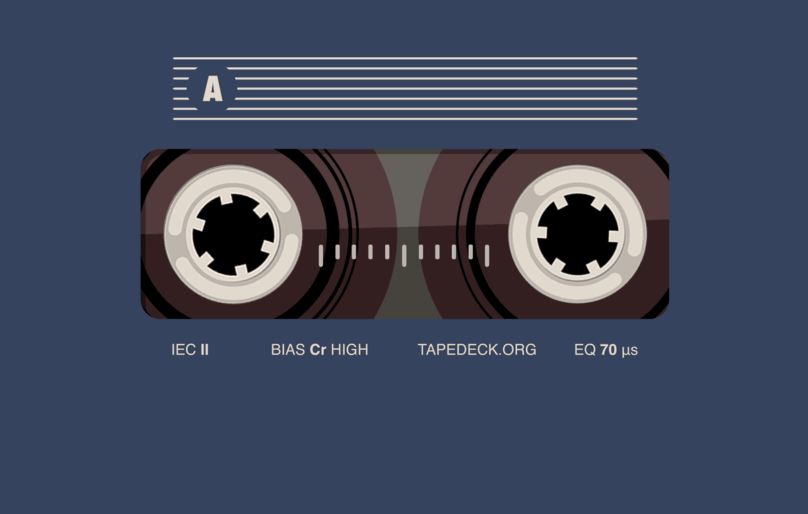
Lyrics based filtering
Lyric-based song recommendation can be done using NLTK in several steps: Data collection: Collect a dataset of lyrics from various songs.
Text preprocessing: Clean and preprocess the lyrics by removing stopwords, punctuation, and special characters.
Vectorization: Convert the preprocessed lyrics into numerical vectors using techniques such as bag-of-words or TF-IDF.
Similarity computation: Compute the similarity between the vectors of different songs using techniques such as cosine similarity.
Recommendation: Use the computed similarities to recommend songs to users. For example, you can recommend songs that have a high similarity to the lyrics of a song that a user is currently listening to.
Back
Notes:
https://duotone.shapefactory.co/?i=phIFdC6lA4E&f=3fc7ff&t=2c0058&q=_

Slide 11
ALGORITHMS
Algorithms used for system
Collaborative filter
Content based filter
Lyrics based recommendation
Back
Notes:
https://duotone.shapefactory.co/?i=phIFdC6lA4E&f=3fc7ff&t=2c0058&q=_

Slide 12
Collaborative Filtering
Matrix factorization is a technique used to decompose a matrix into the product of two or more matrices. These matrices are typically lower-dimensional and have some specific structure, such as being triangular or diagonal. The goal of matrix factorization is to represent the original matrix in a more compact and interpretable form.
These two matrices can be used to make predictions about missing entries or to recommend new items to users.
There are two main types of collaborative filtering algorithms: user-based and item-based.
User-based collaborative filtering: This algorithm makes recommendations based on the similarity between the preferences of a target user and other users. It finds other users who have similar preferences to the target user and recommends items that those similar users have liked.
Item-based collaborative filtering: This algorithm makes recommendations based on the similarity between the items that a target user has liked and all other items. It finds other items that are similar to the items the target user has liked and recommends those similar items to the user.
Both user-based and item-based collaborative filtering can be calculated using nearest neighbour algorithm or matrix factorization techniques. Matrix factorization techniques such as SVD, NMF, and others are also used for collaborative filtering.
Back
Notes:
https://duotone.shapefactory.co/?i=phIFdC6lA4E&f=3fc7ff&t=2c0058&q=_

Slide 13

Content based filtering
Content-based recommendation algorithm has to perform the following two steps. First, extract features out of the content of the song descriptions to create an object representation. Second, define a similarity function among these object representations which mimics what human understands as an item-item similarity. Because we are working with text and words, Term Frequency-Inverse Document Frequency (TF-IDF) can be used for this matching process.
Recommendations done using content-based recommenders can be seen as a user-specific classification problem. This classifier learns the user’s likes and dislikes from the features of the song.
The most straightforward approach is keyword matching. The idea behind is to extract meaningful keywords present in a song description a user likes, search for the keywords in other song descriptions to estimate similarities among them, and based on that, recommend those songs of the user.
TF-IDF is a information retrieval technique that weighs the terms frequency (TF) and inverse document frequency(IDF).The product of these scores of a term is called the TF*IDF weight of that term.
Back
Notes:
https://duotone.shapefactory.co/?i=phIFdC6lA4E&f=3fc7ff&t=2c0058&q=_

Slide 14

Lyrics based recommendation
Explanation of code, assumptions and process flow in project: Each Lyrics in training data has three features : Lyrics,Name,Sentiment. Training data songs have been classified into three sentiments: positive, negative, not defined.
Training :
Created a function to identify lyrics and sentiments from training data.
Removed stop word from lyrics.
Created a bag of words of all lyrics.
Found frequency distribution of all words.
Applied features to filtered corpus and used Naive-Bayes algorithm to train the classifier on training data.
Testing :
Applied classifier on testing data to find sentiments of song based on lyrics.
Calculated accuracy of the model.
Used model to identify sentiment of a string in lyrics for verification purposes.
Back
Notes:
https://duotone.shapefactory.co/?i=phIFdC6lA4E&f=3fc7ff&t=2c0058&q=_

Slide 15
CODE
Collaborative filtering
Content base filtering
Lyrics based recommendation
Back

Slide 16


CONCLUSION
The following are our conclusions based on experiment results. First, music recommender system should consider the music genre information to increase the quality of music recommendations. The music recommender can recommend the songs based on the song features.
The music Recommender can check plagiarism in the dataset taken by generating the similarity score for each recommended song. The mood of the song is predicted by examining the lyrics of the given song with all the other songs in the dataset and predicting the mood and similarity scores and recommending the songs based on the mood. The complex nature of the machine learning systems like the Music Recommendation System can’t have a standardized structure because different music recommender systems work in different way.
Based on our analyses, we can suggest for future research to add other music features in order to improve the accuracy of the recommender system.
Notes:
https://storyset.com/illustration/business-plan/bro
https://duotone.shapefactory.co/?i=c65n6pgkXkI&f=3fc7ff&t=2c0058&q=_

